Slide 1


PEN-TESTING WEB APPLICATION HOSTED ON AWS
http://3.229.76.169/carrental/
ENPM697
Secure Software Construction
Final Project
Security Team Dhanush Devaladakere Arvind
Sumanth Vankineni
Daniel Agrinya

Slide 2
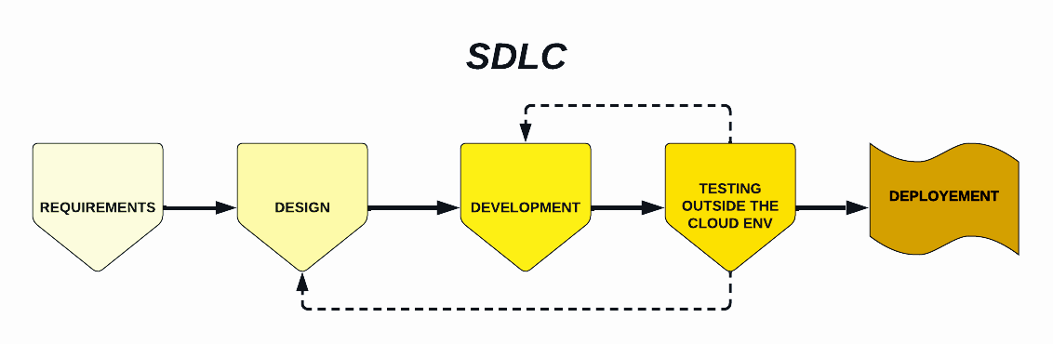
BUILDING THE WEB APPLICATION

Slide 3

Web Application Penetration Testing
Step 1: Information Gathering
Step 2: Vulnerability Analysis
Step 3: Exploitation
Step 4: Post Exploitation
Step 5: Mitigation

Slide 4
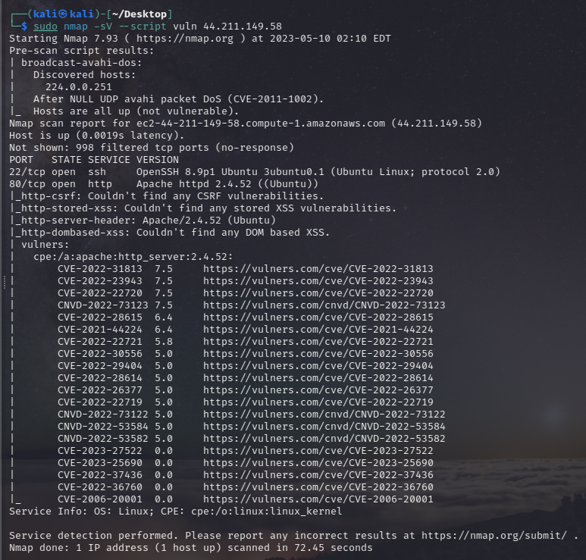
1.Information Gathering
Nmap : It is often used for information gathering and reconnaissance, which is the process of collecting information about a target network or system for the purpose of identifying potential vulnerabilities and attack surfaces.
sudo nmap -sV -sS 44.211.149.58 -A -T4
sudo nmap -sV --script vuln 44.211.149.58
By combining version detection with the vuln script category, Nmap can identify not only the software and version numbers running on open ports, but also any known vulnerabilities associated with those software versions.

Slide 5
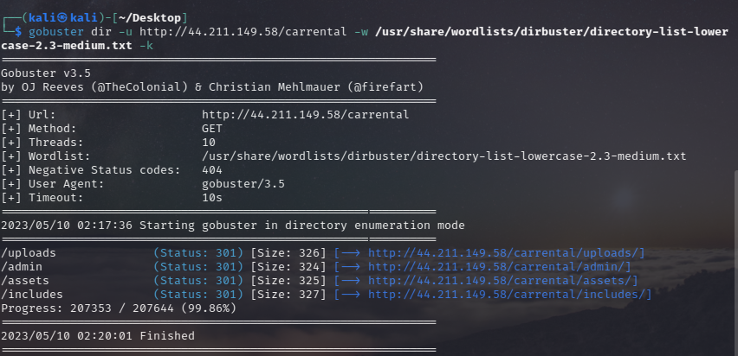
We used the Gobuster Command with a specified wordlist to brute-force directory and file names on the target web server. This can be useful in discovering hidden directories or files that may contain sensitive information or could be exploited in a web application attack. By using the -k flag, Gobuster is configured to ignore SSL/TLS certificate errors, which is useful if the target web server is using a self-signed certificate or a certificate that is not trusted by the Gobuster user.
gobuster dir -u http://44.211.149.58/carrental -w/usr/share/wordlists/dirbuster/directory-list-lowercase-2.3-medium.txt -k

Slide 6
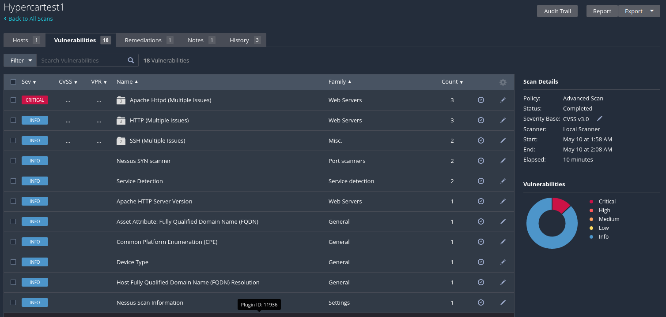
Nessus is a comprehensive network vulnerability scanner that can be used in the reconnaissance phase of a penetration test to identify potential vulnerabilities and misconfigurations on computer systems and networks. It uses a combination of active and passive testing techniques, including vulnerability scanning, port scanning, and service identification, to gather information about the target.
The tool employs a database of known vulnerabilities to identify potential weaknesses and can perform both authenticated and unauthenticated scanning.
Nessus presents the results of the scan in a detailed report that includes information such as the severity of any identified vulnerabilities, recommended remediation steps, and an assessment of overall risk.

Slide 7
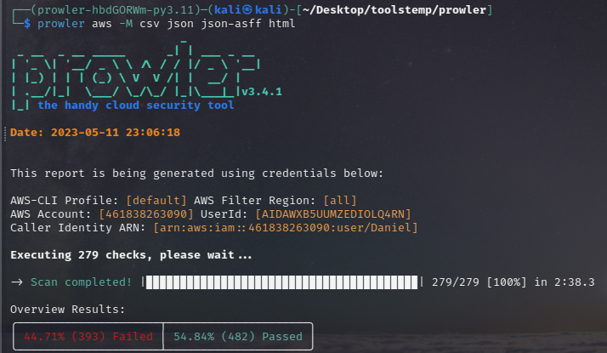
AWS Prowler is a reconnaissance tool designed to evaluate the security posture of an AWS account. It leverages a mix of active and passive testing techniques, such as port scanning, service identification, and vulnerability scanning, to obtain an in-depth understanding of the security controls that are in place within an AWS environment.
Prowler identifies potential security issues by analyzing the collected information, such as misconfigured services, open ports, exposed sensitive data, and inadequate access controls.
The tool uses a comprehensive set of rules to evaluate the security of the target environment and generates a detailed report that includes an overview of the discovered issues, severity ratings, and recommended remediation steps.

Slide 8
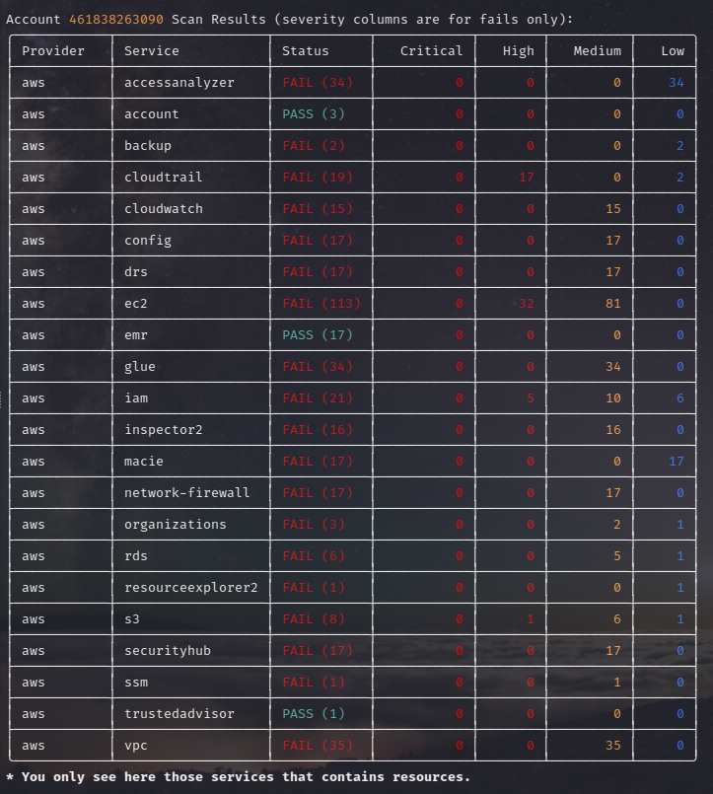

Slide 9
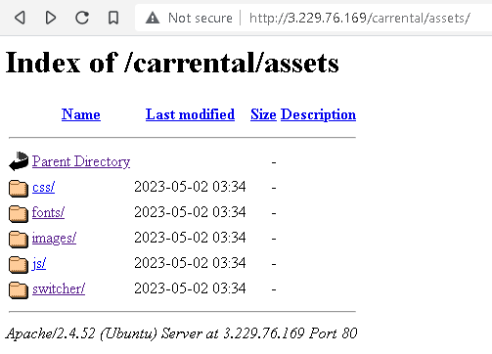
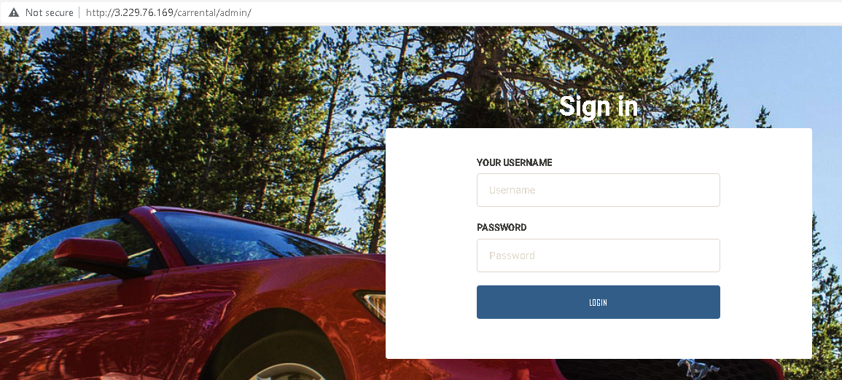
2.Vulnerability Analysis
Apache HTTP Server vulnerability CVE-2022-22720
Apache HTTP Server 2.4.52 and earlier fails to close inbound connection when errors are encountered discarding the request body, exposing the server to HTTP Request Smuggling. (CVE-2022-22720)

Slide 10
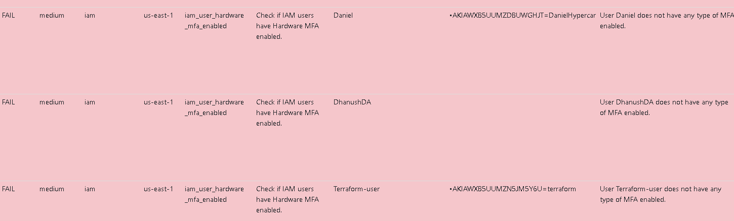

Slide 11

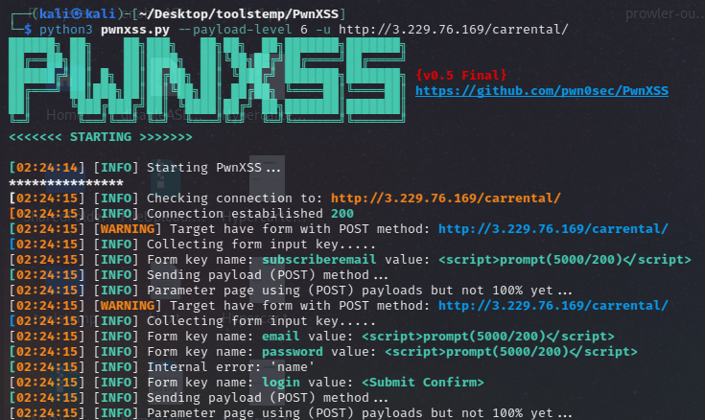
3.Exploitation

Slide 12
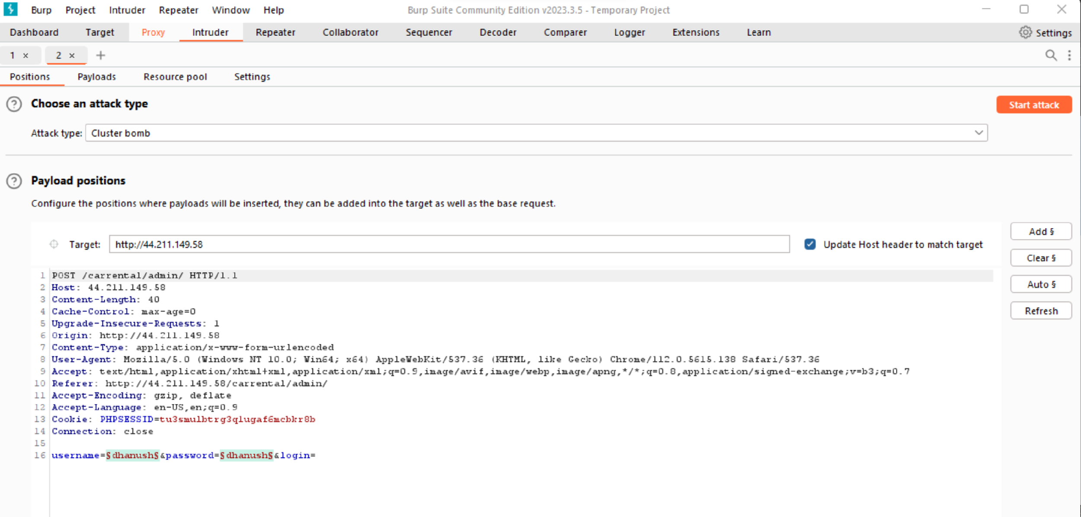

Slide 13
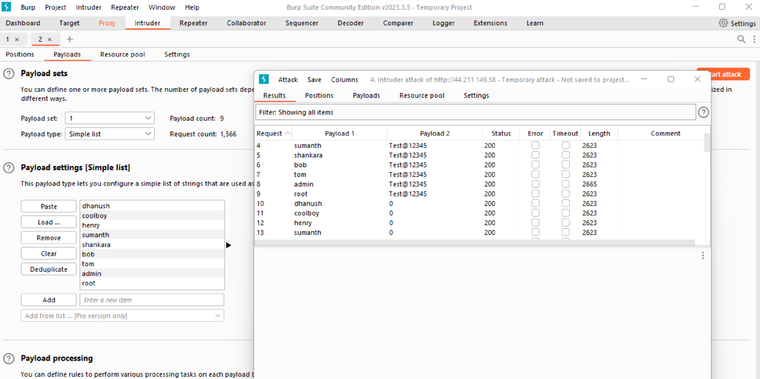

Slide 14
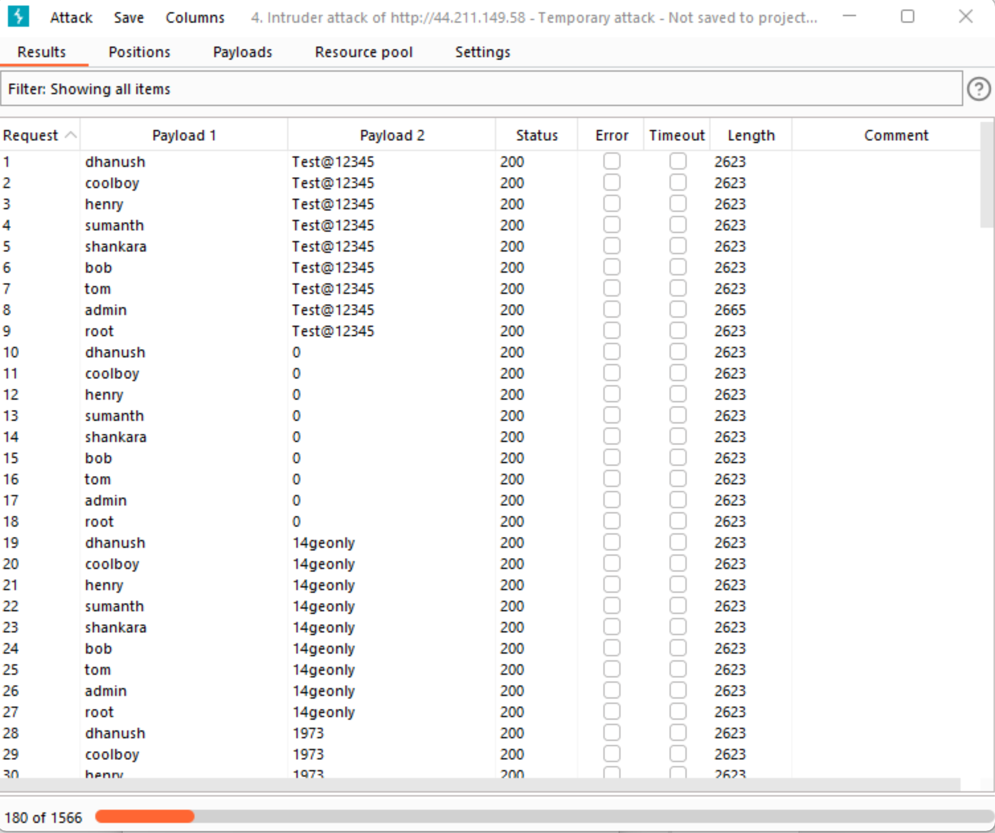

Slide 15
4.Post Exploitation
When preparing an exploitation report, it is important to include the following information:
Overview: Provide a brief summary of the vulnerability, including the affected system, application, or network, the severity of the vulnerability, and any other relevant details.
Methodology: Describe the steps that were taken to identify and exploit the vulnerability. This should include any tools or techniques that were used, as well as any challenges or obstacles that were encountered.
Impact: Explain the potential impact of the vulnerability, including the potential for data loss, system compromise, or other adverse effects.
Recommendations: Provide recommendations for how the target company can mitigate the vulnerability and prevent similar vulnerabilities from occurring in the future. This may include technical recommendations, such as patches or configuration changes, as well as organizational recommendations, such as security awareness training for employees.
Conclusion: Summarize the key findings of the report and emphasize the importance of taking action to address the vulnerability.

Slide 16
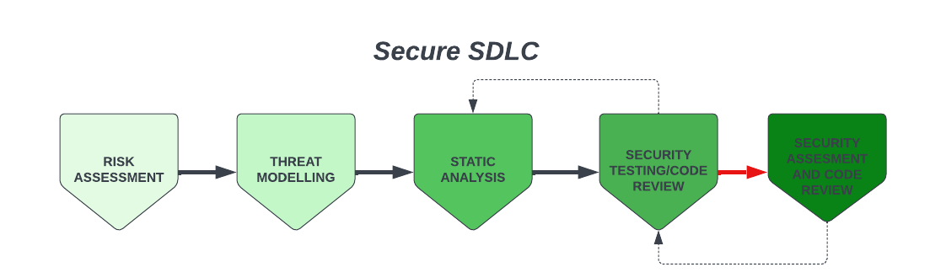
5.Mitigation

Slide 17
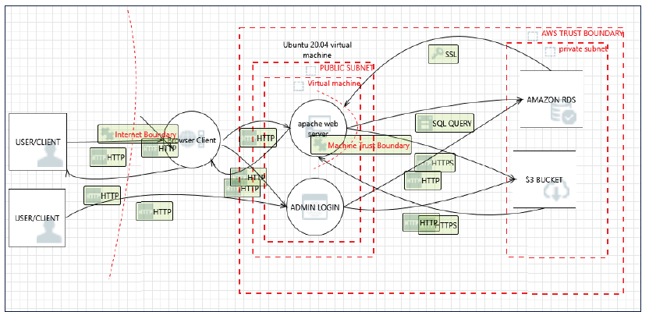

Slide 18
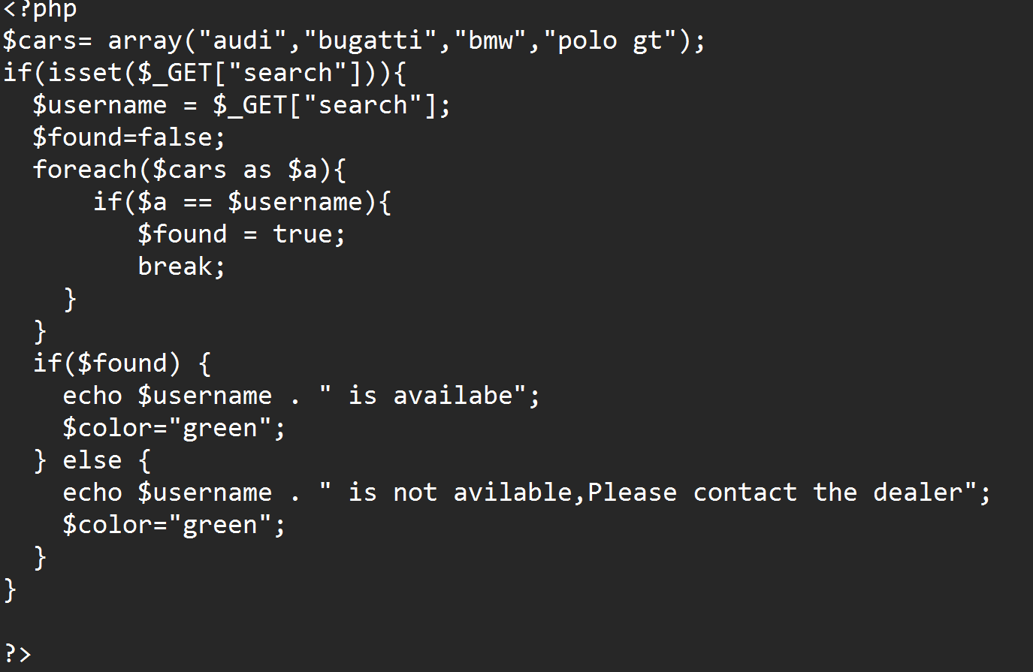
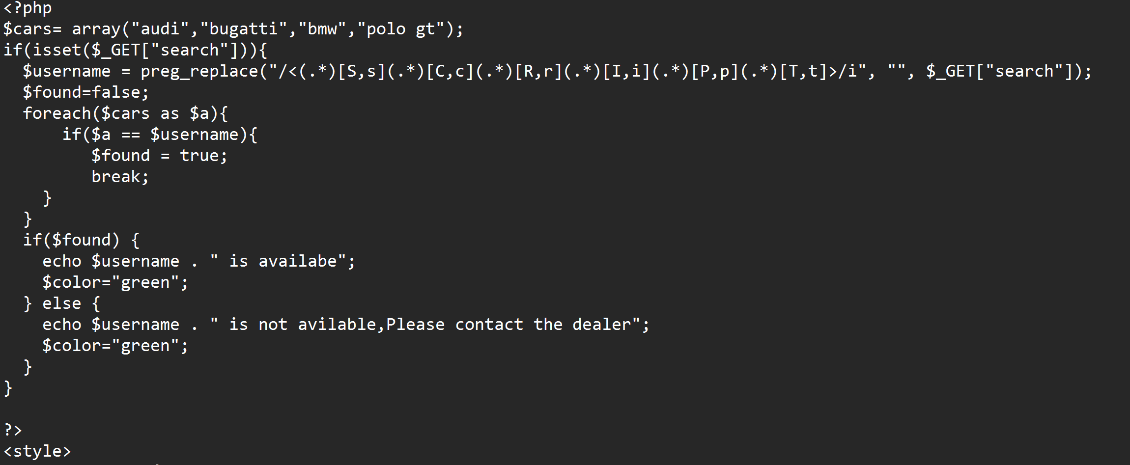
How to prevent Cross-Site Scripting?
Input validation
Output encoding
Use Content Security Policy (CSP)
Use HTTP-only cookies
Keep software up-to-date
Use a web application firewall (WAF)

Slide 19
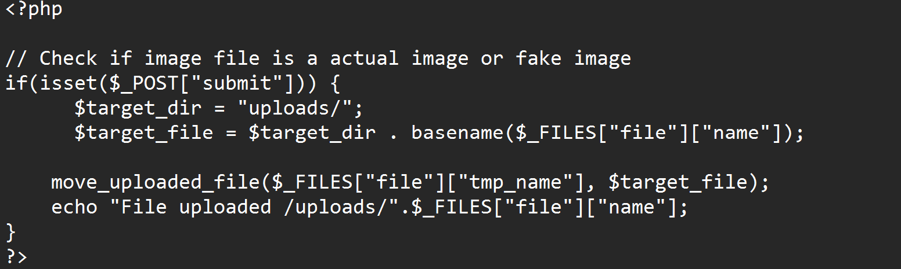
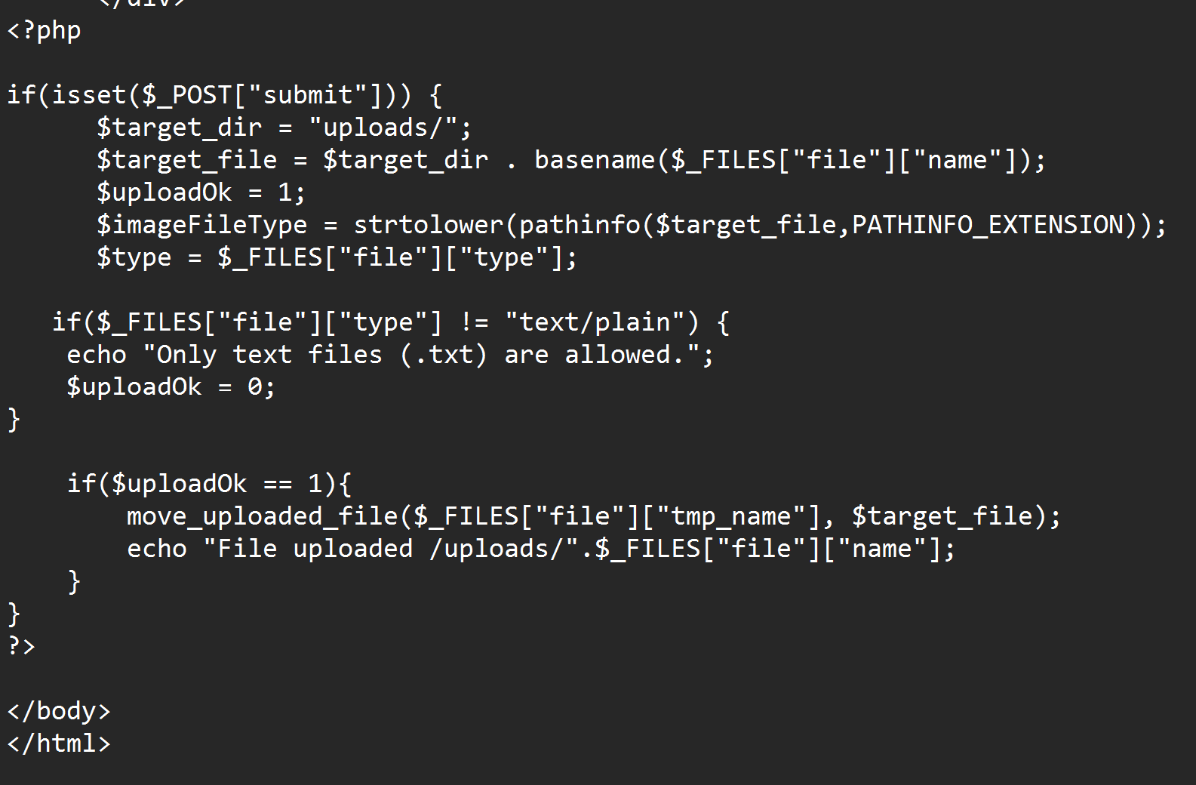
How to prevent File Upload Injection?
Limit file upload size:
Validate file type:
Rename uploaded files:
Store uploaded files outside the web root directory:
Scan uploaded files for malware:
Use secure file permissions

Slide 20
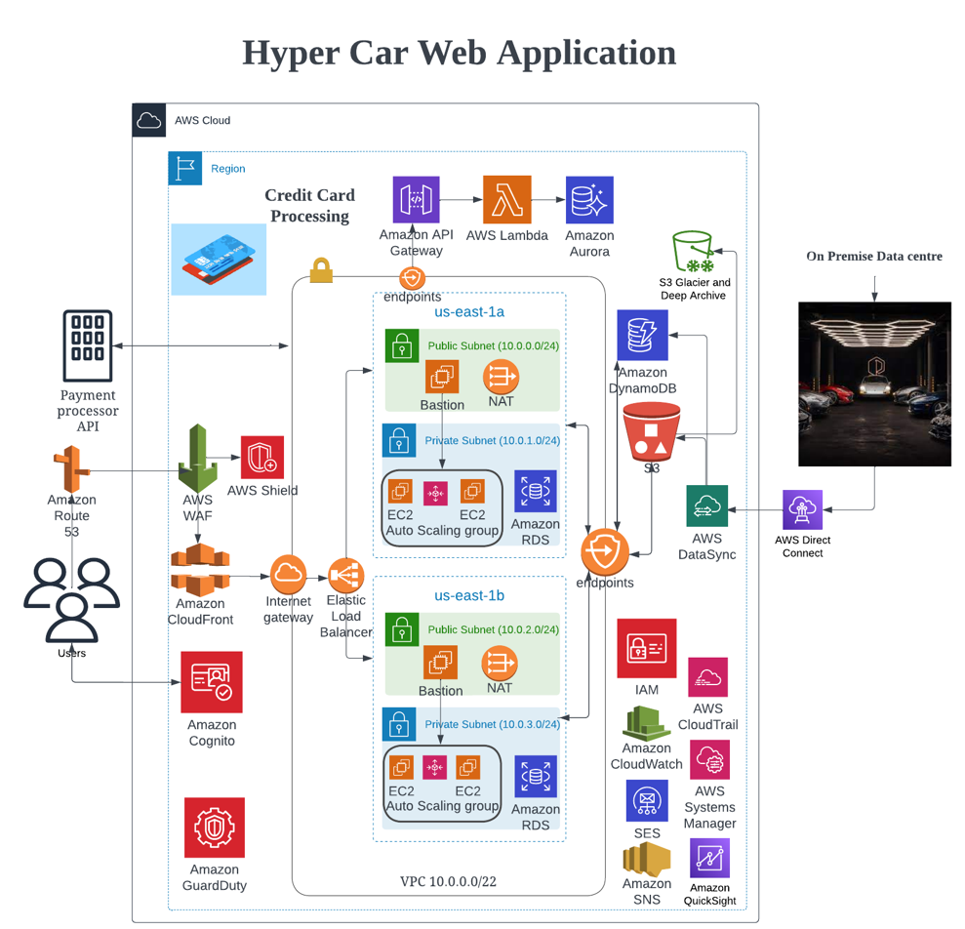

Slide 21

THE END
Thank you for your attention

